Slide 1
Spark on HDInsight Spark SQL
Ali Zaidi
Data Scientist
Machine Learning Education Team

Slide 2


Spark SQL
Relational Data Processing with Spark SQL and DataFrames

Slide 3

Learning objectives
Spark SQL overview
DataFrames
Datasets and Type Safety

Slide 4
Overview

Slide 5
Spark SQL overview
Create an Azure storage or Data Lake Store account
HDInsight makes Apache Spark available as a service in cloud.
Run Spark SQL statements using notebooks
1
2
3
HDInsight uses Azure Blob storage or ADLS for storing data.
Separates compute from storage.
HDInsight makes Apache Spark available as a service in cloud.
You run interactive Spark SQL statements using notebooks, or develop Scala/R/Python scripts.
Notes:
Objective: This slide explains the what and how of Spark SQL.
Talking points:
Functions as an extension to Spark for processing structured data
Part of the core distribution since Spark 1.0 (April 2014)
It is a distributed SQL query engine
It is also a general purpose distributed data processing API

Slide 6
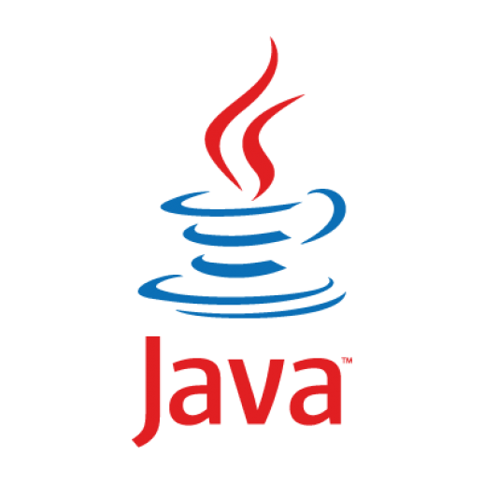
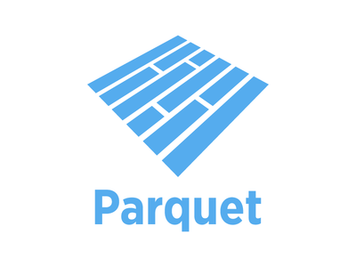

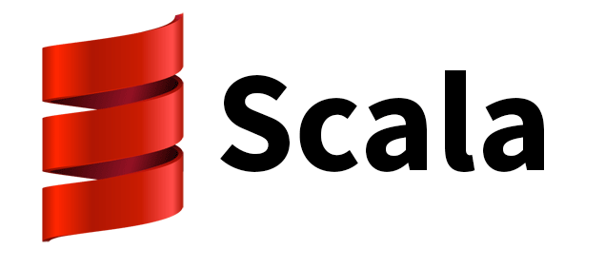



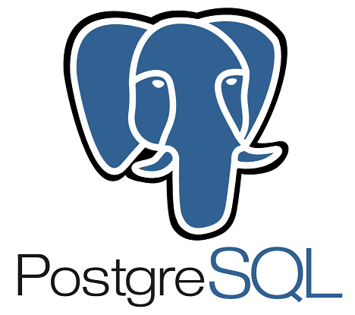
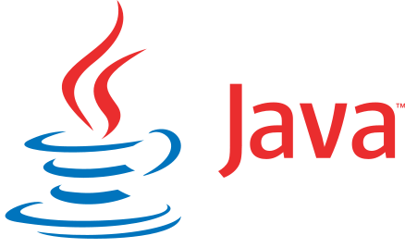



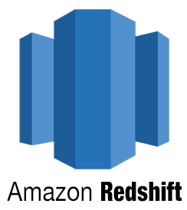
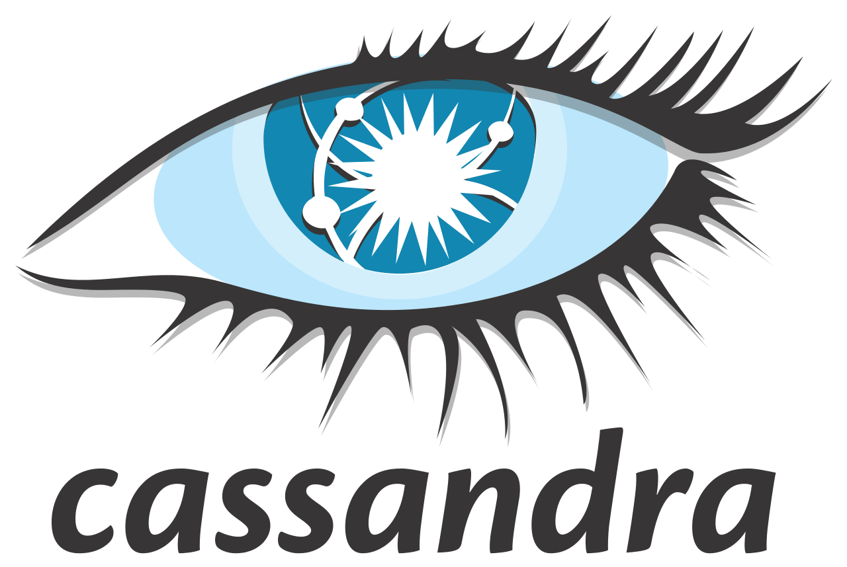






Spark SQL overview
Built-in
External
JDBC
And more…
Notes:
Objective: This slide explains the what and how of Spark SQL.
Talking points:
Supports SQL and HiveQL as query languages
Its capabilities include binding in Python, Scala, and Java
Can query data stored in external databases, structured data files (example: JSON), and Hive tables

Slide 7
Spark SQL
The entry point into all functionality in Spark SQL is the SQLContext class, or one of its descendants. To create a basic SQLContext, all you need is a SparkContext.
>>> val sc: SparkContext // An existing SparkContext.
>>> val sqlContext = new org.apache.spark.sql.SQLContext(sc)
You can also create HiveContext instead of SQLContext. HiveContext is only packaged separately to avoid including all Hive dependencies in the default Spark build.
Spark SQL has been part of the core distribution since 1.0
One of the most complex components, involving sophisticated code generation and intelligent compile time optimizations
Notes:
Objective: This slide describes the different methods Spark SQL introduces and integrates new data.
Talking points:
SQLContext is the entry point into all functionality in Spark SQL, or one of its descendants. To create a basic SQLContext, all you need is a SparkContext.
Future releases will focus on bringing SQLContext up to feature parity with a HiveContext.
HiveContext
An instance of the Spark SQL execution engine that integrates with data stored in Hive. Configuration for Hive is read from hive-site.xml on the classpath. To use a HiveContext, you do not need to have an existing Hive setup, and all of the data sources available to a SQLContext are still available. HiveContext is packaged separately to avoid including all of Hive’s dependencies in the default Spark build. If these dependencies are not a problem for your application, then using HiveContext is recommended for the 1.3 release of Spark.
HiveContext also allows you to:
Write more using the more complete HiveQL parser
Gain access to Hive UDFs
Read data from Hive Tables
Use the spark.sql.dialect option to select the specific variant of the SQL used in the operation.
For SQLContext the only option is “sql”
For HiveContext the only option is “hiveql”

Slide 8
What Kind of SQL Is This?
Spark SQL allows you to process distributed relational data with SQL queries.
It offers two different query languages:
Through the Spark SQLContext, the only supported dialect is “sql,” a rich subset of SQL 92.
Through the HiveContext, the default dialect is "hiveql", corresponding to Hive's SQL dialect. “sql” is also available, but “hiveql” is a richer dialect.

Slide 9
Dude, Where’s my Table?
You submit SQL queries through a SQLContext or HiveContext, using the sql() method
The sql() method returns a DataFrame
As we will see in the R Labs, you can use a DBI engine to submit SQL queries through a separate SQL interface
You can mix DataFrame methods and SQL queries in the same code
To use SQL, you must either:
query a persisted Hive table, or
make a table alias for a DataFrame, using registerTempTable()

Slide 10
DataFrames API – The Preferred Data Abstraction
A distributed collection of data organized into named columns.
Extension to existing RDD API, think of them as RDDs with a Schema
Conceptually equivalent to tables in relational database, or to DataFrames in R/Python.
With domain-specific functions designed for common tasks:
Metadata
Sampling
Project, filter, aggregation, and join
UDFs
RDD ML support deprecated in 2.0
RDDs are a collection of generic objects (such as internal structures unknown to Spark).
User
User
User
User
User
User
DataFrames is a collection of objects with schema that are known to Spark SQL..
Name
Age
Sex
Name
Age
Sex
Name
Age
Sex
Name
Age
Sex
Notes:
Objective: This slide explains the architecture of DataFrames in Spark SQL and how the architecture processes the data.
Talking points:
A DataFrame is a distributed collection of data organized into named columns. It is conceptually equivalent to a table in a relational database or a data frame in R/Python, but with richer optimizations under the hood. DataFrames can be constructed from a wide array of sources such as: structured data files, tables in Hive, external databases, or existing RDDs.
The DataFrame API is available in Scala, Java, and Python.
Once built, DataFrames provide a domain-specific language for distributed data manipulation.
You can also incorporate Spark SQL while working with DataFrames.
Data scientists are employing increasingly sophisticated techniques that go beyond joins and aggregations. To support this, DataFrames can be used directly in the MLlib machine learning pipeline API. In addition, programs can run arbitrarily complex user functions on DataFrames.

Slide 11
Creating DataFrames from data sources
A Spark data source can read in-data to create DataFrames, which has a schema that Spark understands. Examples include: JSON files, JDBC source, Parquet, and Hive tables.
>>> val df = sqlContext.jsonFile(”somejasonfile.json“) //from JSON file*
>>> val df = hiveContext.table(”somehivetable“) //from a Hive Table
>>> val df = sqlContext.parquetFile(”someparquetsource“) //from a parquet file
>>> val df = sqlContext.load(source="jdbc", url=“UrlToConnect", dbtable=“tablename")//from JDBC source
* Note that the file that is offered as jsonFile is not a typical JSON file. Each line must contain a separate, self-contained valid JSON object. A regular multi-line JSON file will most often fail.
Notes:
Objective: This slide describes the different ways a DataFrame can be created through a data source.
Talking points:
Spark SQL supports operating on a variety of data sources through the DataFrame interface. A DataFrame can be operated on as a normal RDD and or registered as a temporary table. Registering a DataFrame as a table allows you to run SQL queries over its data. This section describes the general methods for loading and saving data using the Spark data sources and then goes into specific options that are available for the built-in data sources.
JSON file
You can also manually specify the data source that will be used along with any extra options that you would like to pass to the data source. Data sources are specified by their fully qualified name (for example, org.apache.spark.sql.parquet), but for built-in sources you can also use the shortened name (JSON, Parquet, JDBC). DataFrames of any type can be converted into other types using this syntax.
Spark SQL can automatically infer the schema of a JSON dataset and load it as a DataFrame. This conversion can be done using one of two methods in a SQLContext:
jsonFile – Loads data from a directory of JSON files, where each line of the files is a JSON object.
jsonRDD – Loads data from an existing RDD, where each element of the RDD is a string containing a JSON object.
Note that the file that is offered as jsonFile is not a typical JSON file. Each line must contain a separate, self-contained valid JSON object. As a consequence, a regular multi-line JSON file will most often fail.
Hive table
Spark SQL also supports reading and writing data stored in Apache Hive. However, since Hive has a large number of dependencies, it is not included in the default Spark assembly. Hive support is enabled by adding the -Phive and -Phive-thriftserver flags to the Spark build. This command builds a new assembly jar that includes Hive. Note that this Hive assembly jar must also be present on all of the worker nodes, as they will need access to the Hive serialization and deserialization libraries (SerDes) in order to access data stored in Hive.
Configuration of Hive is done by placing your hive-site.xml file in conf/.
Parquet file
In the simplest form, the default data source (parquet unless otherwise configured by spark.sql.sources.default) will be used for all operations.
Java Database Connectivity (JDBC) source
Spark SQL also includes a data source that can read data from other databases using JDBC. This functionality should be preferred over using JdbcRDD. This is because the results are returned as a DataFrame and can be easily processed in Spark SQL or joined with other data sources. The JDBC data source is also easier to use from Java or Python as it does not require the user to provide a ClassTag. (Note that this is different than the Spark SQL JDBC server, which allows other applications to run queries using Spark SQL.)

Slide 12
Creating DataFrames from RDDs
Create DataFrames from existing RDDs in two ways:
Use reflection: Infer the schema of an RDD that contains specific types of objects. This approach leads to more concise code. It works well when you already know the schema while writing your Spark application.
Specify the schema programmatically: Enables you to construct a schema then apply it to an existing RDD. This method is more verbose, but it enables you to construct DataFrames when the columns and their types are not known until runtime.
Create DataFrames from existing a JSON RDD, using the jsonRDD function.
>>> val df = sqlContext.jsonRDD(anUserRDD)
Notes:
Objective: This slide describe the different ways a DataFrame can be created through an RDD.
Talking points:
Using reflection:
The Scala interface for Spark SQL supports automatically converting an RDD containing case classes to a DataFrame. The case class defines the schema of the table. The names of the arguments to the case class are read using reflection and become the names of the columns. Case classes can also be nested or contain complex types such as sequences or arrays. This RDD can be implicitly converted to a DataFrame and then registered as a table. Tables can be used in subsequent SQL statements.
Specifying the schema programmatically:
When case classes cannot be defined ahead of time (for example, the structure of records is encoded in a string, or a text dataset will be parsed and fields projected differently for distinct users), a DataFrame can be created programmatically with three steps:
Create an RDD of rows from the original RDD
Create the schema represented by a StructType matching the structure of rows in the RDD created in Step 1
Apply the schema to the RDD of rows via the createDataFrame method provided by SQLContext.

Slide 13
DataFrame operations
DataFrames provide a domain-specific language for structured data manipulation in Scala, Java, and Python.
>>> val df = sqlContext.jsonFile(”somejasonfile.json“)
>>> df.show() // Show the contents of the DataFrame
>>> df.printSchema() // Print the schema in a tree format
>>> df.select(“name”).show() // Select and show the name columns
>>> df.select(df(”name”),df (“age”) +1).show() // Select all but increment the age by 1
>>> df.filter(df(”age”) > 21).show() // Select people older than 21
>>> df.groupBy(“age”).count().show() // Count people by age
Notes:
Objective: This slide describes the various DataFrame operations in Scala, Java, and Python.
Talking points:
Through certain DataFrame operations, you can use SQLContext to understand the construction and demographics of your data.
df.show() – This operation shows the contents of the data you have selected
df.printSchema() – This operation prints your schema (table) in a tree format
df.select(“name”).show() – This operation will select and display the name you have selected for the columns you’ve specified
df.select(dr(“name”),df(“age”) + 1).show() – This operation example will select all your data as well as add one to each of the ages shown
df.filter(df(“age”) > a21.show() – This operation example will select all data that shows that the data is greater than 21
Df.groupBy(“age”).count().show() – This operation example will count the data you’ve selected by age and show you only the results that meet the criteria you’ve presented

Slide 14


Tables and queries
A DataFrame can be registered as a table that can then be used in SQL queries.
// First create a DataFrame from JSON file.
>>> val df = sqlContext.jsonFile(”Users.json“)
// Register the DataFrame as a temporary table. Temp tables exist only during lifetime of this SQLContext instance.
>>> val usertable = sqlContext.registerDataFrameAsTable(df, “UserTable”)
// Alternatively, execute a SQL query on the table. The query returns a DataFrame.
>>> val teenagers = sqlContext.sql(“select Age as Years from UserTable where age > 13 and age <= 19”)
JSON file
DataFrame
Register DataFrame as table
SQL query
DataFrame
Notes:
Objective: This slide frames the DataFrames that can be registered as a table to be used in SQL queries.
Talking points:
To analyze or query your data in SQL, you can use the following method to create and register your DataFrame from a JSON file into SQLContext to perform executable SQL queries.

Slide 15
Hive tables
Spark SQL also supports reading and writing data stored in Apache Hive.
// Create a HiveContext, which is derived from SQLContext. >>> val sqlContext = new org.apache.spark.sql.hive.HiveContext(sc)
>>> sqlContext.sql("CREATE TABLE IF NOT EXISTS UserTable (key INT, value STRING)")
>>> sqlContext.sql("LOAD DATA LOCAL INPATH ‘user.txt' INTO TABLE UserTable")
// Queries are expressed in HiveQL.
>>> val df = sqlContext.sql("FROM UserTable SELECT Name, Age")
Notes:
Objective: This slide shows how Spark SQL supports reading and writing data stored in another tool, Apache Hive.
Talking points:
Spark SQL supports reading and writing data stored in Apache Hive. However, since Hive has a large number of dependencies, it is not included in the default Spark assembly. Hive support is enabled by adding the -Phive and -Phive-thriftserver flags to the Spark build. This command builds a new assembly jar that includes Hive. Note that this Hive assembly jar must also be present on all of the worker nodes, as they will need access to the Hive serialization and deserialization libraries (SerDes) in order to access data stored in Hive.
Configuration of Hive is done by placing your hive-site.xml file in conf/
Saving to persistent tables:
When working with a HiveContext, it is possible to save a DataFrame persistently. Persistent tables continue to exist even after your Spark program has restarted. Just make sure to maintain your connection to the same metastore.
saveAsTable() saves the content of the DataFrame to a data source as a table. It then materializes the contents of the DataFrame and creates a pointer to the data in the HiveMetastore.
By default, saveAsTable creates a “managed table.” The megastore controls the location of the data, and automatically deletes data on the managed tables when a table is dropped.

Slide 16
Query Plans and Optimizations in Spark SQL

Slide 17
The Art of Being Lazy
Just as with RDDs, DataFrames are evaluated lazily.
Transformations contribute the query plan, but are not executed upon invocation.
Actions cause the execution of a query
Transformations:
select
filter
groupBy
intersect
join
Actions:
count
collect
head
take
Notes:
Objective: This slide shows how Spark SQL supports reading and writing data stored in another tool, Apache Hive.
Talking points:
Spark SQL supports reading and writing data stored in Apache Hive. However, since Hive has a large number of dependencies, it is not included in the default Spark assembly. Hive support is enabled by adding the -Phive and -Phive-thriftserver flags to the Spark build. This command builds a new assembly jar that includes Hive. Note that this Hive assembly jar must also be present on all of the worker nodes, as they will need access to the Hive serialization and deserialization libraries (SerDes) in order to access data stored in Hive.
Configuration of Hive is done by placing your hive-site.xml file in conf/
Saving to persistent tables:
When working with a HiveContext, it is possible to save a DataFrame persistently. Persistent tables continue to exist even after your Spark program has restarted. Just make sure to maintain your connection to the same metastore.
saveAsTable() saves the content of the DataFrame to a data source as a table. It then materializes the contents of the DataFrame and creates a pointer to the data in the HiveMetastore.
By default, saveAsTable creates a “managed table.” The megastore controls the location of the data, and automatically deletes data on the managed tables when a table is dropped.

Slide 18
Transformations, Actions, Laziness
Like RDDs, DataFrames are lazy.
Transformations contribute to the query plan, but they don't execute anything.
Actions cause the execution of the query.
Transformation examples
Action examples
filter
select
groupBy
intersect
join
count
collect
take
head
show
Notes:
Head is non-deterministic, could change between jobs. Just the first partition that materialized returns results.

Slide 19
Transformations, Actions, Laziness
Actions cause the execution of the query.
What, exactly, does “execution of the query” mean? It means:
Spark initiates a distributed read of the data source
The data flows through the transformations (the RDDs resulting from the Catalyst query plan)
The result of the action is pulled back into the driver JVM.

Slide 20
Catalyst Query Optimizer
Since DataFrames are evaluated lazily, the full DAG is available to compute and optimize
Analysis
Logical
Optimization
Physical
Planning
Code
Generation
SQL AST
Unresolved Logical Plan
Logical Plan
Optimized Logical Plan
Physical Plans
Selected Physical Plan
RDDs
Cost Model
DataFrame
Catalog
Notes:
Unlike the eagerly evaluated data frames in R and Python, DataFrames in Spark have their execution automatically optimized by a query optimizer. Before any computation on a DataFrame starts, the Catalyst optimizer compiles the operations that were used to build the DataFrame into a physical plan for execution. Because the optimizer understands the semantics of operations and structure of the data, it can make intelligent decisions to speed up computation.
At a high level, there are two kinds of optimizations.
First, Catalyst applies logical optimizations such as predicate pushdown. The optimizer can push filter predicates down into the data source, enabling the physical execution to skip irrelevant data. In the case of Parquet files, entire blocks can be skipped and comparisons on strings can be turned into cheaper integer comparisons via dictionary encoding. In the case of relational databases, predicates are pushed down into the external databases to reduce the amount of data traffic.
Second, Catalyst compiles operations into physical plans for execution and generatesJVM bytecode for those plans that is often more optimized than hand-written code. For example, it can choose intelligently between broadcast joins and shuffle joins to reduce network traffic. It can also perform lower level optimizations such as eliminating expensive object allocations and reducing virtual function calls. As a result, we expect performance improvements for existing Spark programs when they migrate to DataFrames.

Slide 21
Logical Plan Optimization and Physical Execution
joined = users.join(events, users.id == events.uid)
filtered = joined.filter(events.date >= "2015-01-01")
logical plan
filter
this join is expensive →
join
scan
(users)
scan
(events)
Notes:
Unlike the eagerly evaluated data frames in R and Python, DataFrames in Spark have their execution automatically optimized by a query optimizer. Before any computation on a DataFrame starts, the Catalyst optimizer compiles the operations that were used to build the DataFrame into a physical plan for execution. Because the optimizer understands the semantics of operations and structure of the data, it can make intelligent decisions to speed up computation.
At a high level, there are two kinds of optimizations.
First, Catalyst applies logical optimizations such as predicate pushdown. The optimizer can push filter predicates down into the data source, enabling the physical execution to skip irrelevant data. In the case of Parquet files, entire blocks can be skipped and comparisons on strings can be turned into cheaper integer comparisons via dictionary encoding. In the case of relational databases, predicates are pushed down into the external databases to reduce the amount of data traffic.
Second, Catalyst compiles operations into physical plans for execution and generatesJVM bytecode for those plans that is often more optimized than hand-written code. For example, it can choose intelligently between broadcast joins and shuffle joins to reduce network traffic. It can also perform lower level optimizations such as eliminating expensive object allocations and reducing virtual function calls. As a result, we expect performance improvements for existing Spark programs when they migrate to DataFrames.

Slide 22
Logical Plan Optimization and Physical Execution
joined = users.join(events, users.id == events.uid)
filtered = joined.filter(events.date >= "2015-01-01")
logical plan
optimized plan
filter
join
join
scan
(users)
filter
scan
(users)
scan
(events)
scan
(events)
Notes:
Unlike the eagerly evaluated data frames in R and Python, DataFrames in Spark have their execution automatically optimized by a query optimizer. Before any computation on a DataFrame starts, the Catalyst optimizer compiles the operations that were used to build the DataFrame into a physical plan for execution. Because the optimizer understands the semantics of operations and structure of the data, it can make intelligent decisions to speed up computation.
At a high level, there are two kinds of optimizations.
First, Catalyst applies logical optimizations such as predicate pushdown. The optimizer can push filter predicates down into the data source, enabling the physical execution to skip irrelevant data. In the case of Parquet files, entire blocks can be skipped and comparisons on strings can be turned into cheaper integer comparisons via dictionary encoding. In the case of relational databases, predicates are pushed down into the external databases to reduce the amount of data traffic.
Second, Catalyst compiles operations into physical plans for execution and generatesJVM bytecode for those plans that is often more optimized than hand-written code. For example, it can choose intelligently between broadcast joins and shuffle joins to reduce network traffic. It can also perform lower level optimizations such as eliminating expensive object allocations and reducing virtual function calls. As a result, we expect performance improvements for existing Spark programs when they migrate to DataFrames.

Slide 23
Logical Plan Optimization and Physical Execution
joined = users.join(events, users.id == events.uid)
filtered = joined.filter(events.date >= "2015-01-01")
logical plan
optimized plan
optimized plan
with intelligent data sources
filter
join
join
join
scan
(users)
filter
scan
(users)
scan
(events)
scan
(events)
scan
(users)
filter scan
(events)
filter done by data source (e.g., RDBMS via JDBC)
Notes:
Unlike the eagerly evaluated data frames in R and Python, DataFrames in Spark have their execution automatically optimized by a query optimizer. Before any computation on a DataFrame starts, the Catalyst optimizer compiles the operations that were used to build the DataFrame into a physical plan for execution. Because the optimizer understands the semantics of operations and structure of the data, it can make intelligent decisions to speed up computation.
At a high level, there are two kinds of optimizations.
First, Catalyst applies logical optimizations such as predicate pushdown. The optimizer can push filter predicates down into the data source, enabling the physical execution to skip irrelevant data. In the case of Parquet files, entire blocks can be skipped and comparisons on strings can be turned into cheaper integer comparisons via dictionary encoding. In the case of relational databases, predicates are pushed down into the external databases to reduce the amount of data traffic.
Second, Catalyst compiles operations into physical plans for execution and generatesJVM bytecode for those plans that is often more optimized than hand-written code. For example, it can choose intelligently between broadcast joins and shuffle joins to reduce network traffic. It can also perform lower level optimizations such as eliminating expensive object allocations and reducing virtual function calls. As a result, we expect performance improvements for existing Spark programs when they migrate to DataFrames.

Slide 24
Intelligent Data Sources
The Data Sources API can automatically prune columns and push filters to the source
Parquet: skip irrelevant columns and blocks of data; turn string comparison into integer comparisons for dictionary encoded data
JDBC: Rewrite queries to push predicates down
Notes:
Unlike the eagerly evaluated data frames in R and Python, DataFrames in Spark have their execution automatically optimized by a query optimizer. Before any computation on a DataFrame starts, the Catalyst optimizer compiles the operations that were used to build the DataFrame into a physical plan for execution. Because the optimizer understands the semantics of operations and structure of the data, it can make intelligent decisions to speed up computation.
At a high level, there are two kinds of optimizations.
First, Catalyst applies logical optimizations such as predicate pushdown. The optimizer can push filter predicates down into the data source, enabling the physical execution to skip irrelevant data. In the case of Parquet files, entire blocks can be skipped and comparisons on strings can be turned into cheaper integer comparisons via dictionary encoding. In the case of relational databases, predicates are pushed down into the external databases to reduce the amount of data traffic.
Second, Catalyst compiles operations into physical plans for execution and generatesJVM bytecode for those plans that is often more optimized than hand-written code. For example, it can choose intelligently between broadcast joins and shuffle joins to reduce network traffic. It can also perform lower level optimizations such as eliminating expensive object allocations and reducing virtual function calls. As a result, we expect performance improvements for existing Spark programs when they migrate to DataFrames.

Slide 25

Explain
You can dump the query plan to standard output, so you can get an idea of how Spark will execute your query.
scala> val df3 = df.join(df2, (df("first_name") === df2("firstName")) & (df("last_name") === df2("lastName"))
scala> df3.explain()
ShuffledHashJoin [last_name#18], [lastName#36], BuildRight
Exchange (HashPartitioning 200)
PhysicalRDD [first_name#17,last_name#18,gender#19,age#20L], MapPartitionsRDD[41] at applySchemaToPythonRDD at NativeMethodAccessorImpl.java:-2
Exchange (HashPartitioning 200)
PhysicalRDD [firstName#35,lastName#36,medium#37], MapPartitionsRDD[118] at executedPlan at NativeMethodAccessorImpl.java:-2

Slide 26
Explain
Pass true to get a more detailed query plan.
scala> df.join(df2, lower(df("firstName")) === lower(df2("firstName"))).explain(true)
== Parsed Logical Plan ==
Join Inner, Some((Lower(firstName#1) = Lower(firstName#13)))
Relation[birthDate#0,firstName#1,gender#2,lastName#3,middleName#4,salary#5L,ssn#6] org.apache.spark.sql.json.JSONRelation@7cbb370e
Relation[firstName#13,lastName#14,medium#15] org.apache.spark.sql.json.JSONRelation@e5203d2c
== Analyzed Logical Plan ==
birthDate: string, firstName: string, gender: string, lastName: string, middleName: string, salary: bigint, ssn: string, firstName: string, lastName: string, medium: string
Join Inner, Some((Lower(firstName#1) = Lower(firstName#13)))
Relation[birthDate#0,firstName#1,gender#2,lastName#3,middleName#4,salary#5L,ssn#6] org.apache.spark.sql.json.JSONRelation@7cbb370e
Relation[firstName#13,lastName#14,medium#15] org.apache.spark.sql.json.JSONRelation@e5203d2c
== Optimized Logical Plan ==
Join Inner, Some((Lower(firstName#1) = Lower(firstName#13)))
Relation[birthDate#0,firstName#1,gender#2,lastName#3,middleName#4,salary#5L,ssn#6] org.apache.spark.sql.json.JSONRelation@7cbb370e
Relation[firstName#13,lastName#14,medium#15] org.apache.spark.sql.json.JSONRelation@e5203d2c
== Physical Plan ==
ShuffledHashJoin [Lower(firstName#1)], [Lower(firstName#13)], BuildRight
Exchange (HashPartitioning 200)
PhysicalRDD [birthDate#0,firstName#1,gender#2,lastName#3,middleName#4,salary#5L,ssn#6], MapPartitionsRDD[40] at explain at <console>:25
Exchange (HashPartitioning 200)
PhysicalRDD [firstName#13,lastName#14,medium#15], MapPartitionsRDD[43] at explain at <console>:25
Code Generation: false
== RDD ==

Slide 27
DataFrame limitations
Catalyst does not automatically repartition DataFrames optimally
During a DF shuffle, Spark SQL will just use
spark.sql.shuffle.partitions
to determine the number of partitions in the downstream RDD
All SQL configurations can be changed
via sqlContext.setConf(key, value)
Notes:
Can you also please repeat what are the ~3 fundamental transformations that you use when processing the DAG of DFs?“
Note that Spark conf can't be altered, but sql config can.

Slide 28

Creating a DataFrame in Scala
import org.apache.spark.{SparkConf, SparkContext}
import org.apache.spark.sql.SQLContext
val conf = new SparkConf().setAppName(appName).
setMaster(master)
// Returns existing SparkContext, if there is one;
// otherwise, creates a new one from the config.
val sc = SparkContext.getOrCreate(conf)
// Ditto.
val sqlContext = SQLContext.getOrCreate(sc)
val df = sqlContext.read.parquet("/path/to/data.parquet")
val df2 = sqlContext.read.json("/path/to/data.json")

Slide 29

Creating a DataFrame in Python
# The import isn't necessary in the SparkShell or Databricks
from pyspark import SparkContext, SparkConf
# The following three lines are not necessary
# in the pyspark shell
conf = SparkConf().setAppName(appName).setMaster(master)
sc = SparkContext(conf=conf)
sqlContext = SQLContext(sc)
df = sqlContext.read.parquet("/path/to/data.parquet")
df2 = sqlContext.read.json("/path/to/data.json")

Slide 30
printSchema()
You can have Spark tell you what it thinks the data schema is, by calling the printSchema() method. (This is mostly useful in the shell.)
> df.printSchema()
root |-- firstName: string (nullable = true) |-- lastName: string (nullable = true) |-- gender: string (nullable = true) |-- age: integer (nullable = false)

Slide 31
Schema Inference
Some data sources (e.g., Parquet) can expose a formal schema; others (e.g., plain text files) don’t. How do we fix that?
You can create an RDD of a particular type and let Spark infer the schema from that type. We’ll see how to do that in a moment.
You can use the API to specify the schema programmatically.
Notes:
Refer people to the Spark Programming Guide (spark.apache.org) for all the gory details.

Slide 32
Schema Inference Example
Suppose you have a (text) file that looks like this:
Erin,Shannon,F,42
Norman,Lockwood,M,81
Miguel,Ruiz,M,64
Rosalita,Ramirez,F,14
Ally,Garcia,F,39
Claire,McBride,F,23
Abigail,Cottrell,F,75 José,Rivera,M,59 Ravi,Dasgupta,M,25 …
The file has no schema, but it’s obvious there is one:
First name: string Last name: string Gender: string Age: integer
Let’s see how to get Spark to infer the schema.

Slide 33

Schema Inference (Scala)
import sqlContext.implicits._
case class Person(firstName: String,
lastName: String,
gender: String,
age: Int)
val rdd = sc.textFile("people.csv")
val peopleRDD = rdd.map { line =>
val cols = line.split(",")
Person(cols(0), cols(1), cols(2), cols(3).toInt)
}
val df = peopleRDD.toDF
// df: DataFrame = [firstName: string, lastName: string, gender: string, age: int]
Notes:
Notice this is problematic, all columns are treated as strings (including age)
You’d want to be more robust about parsing CSV in real life.
The serializer can’t easily infer the types of the columns if you use a Python class. A namedtuple is preferred.

Slide 34
Schema Inference (Python)
from pyspark.sql import Row
rdd = sc.textFile("people.csv")
Person = Row('first_name', 'last_name', 'gender', 'age')
def line_to_person(line):
cells = line.split(",")
cells[3] = int(cells[3])
return Person(*cells)
peopleRDD = rdd.map(line_to_person)
df = peopleRDD.toDF()
# DataFrame[first_name: string, last_name: string, \
# gender: string, age: bigint]
Notes:
This also works in Scala…
Notice this is problematic, all columns are treated as strings (including age)
You’d want to be more robust about parsing CSV in real life.
The serializer can’t easily infer the types of the columns if you use a Python class. A namedtuple is preferred.

Slide 35
Schema Inference
We can also force schema inference
without creating our own Person type,
by using a fixed-length data structure (such as a tuple)
and supplying the column names to the toDF() method.

Slide 36
Schema Inference (Scala)
val rdd = sc.textFile("people.csv")
val peopleRDD = rdd.map { line =>
val cols = line.split(",")
(cols(0), cols(1), cols(2), cols(3).toInt)
}
val df = peopleRDD.toDF("firstName", "lastName",
"gender", "age")
If you don’t supply the column names, the API defaults to “_1”, “_2”, etc.
Notes:
You’d want to be more robust about parsing CSV in real life.

Slide 37
Schema Inference (Python)
rdd = sc.textFile("people.csv")
def line_to_person(line):
cells = line.split(",")
return (cells[0], cells[1], cells[2], int(cells[3]))
peopleRDD = rdd.map(line_to_person)
df = peopleRDD.toDF(['first_name', 'last_name', 'gender', 'age'])
# DataFrame[first_name: string, last_name: string, \
# gender: string, age: bigint]
Notes:
You’d want to be more robust about parsing CSV in real life.
The serializer can’t easily infer the types of the columns if you use a Python class. A namedtuple is preferred.

Slide 38
Schema Inference (Python)
from collections import namedtuple
Person = namedtuple('Person',
['first_name', 'last_name', 'gender', 'age']
)
rdd = sc.textFile("people.csv")
def line_to_person(line):
cells = line.split(",")
return Person(cells[0], cells[1], cells[2], int(cells[3]))
peopleRDD = rdd.map(line_to_person)
df = peopleRDD.toDF()
# DataFrame[first_name: string, last_name: string, \
# gender: string, age: bigint]
Notes:
You’d want to be more robust about parsing CSV in real life.
The serializer can’t easily infer the types of the columns if you use a Python class. A namedtuple is preferred.

Slide 39
Datasets and DataFrame Optimizations Using Catalyst

Slide 40
From RDD to Dataset: What is RDD?
Partitions: distributed data
Lineage: dependencies
Compute function: Partition => Iterator[T]

Slide 41
From RDD to Dataset: What is RDD?
Partitions: distributed data
Lineage: dependencies
Compute function: Partition => Iterator[T]
Opaque computation and data

Slide 42
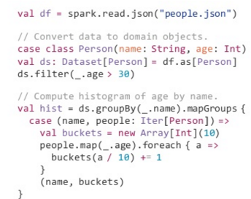
From RDD to Dataset: What is Dataset?
Structured computation and data
Data types have known structure
Computations are type-safe

Slide 43
Structured APIs in Spark
 | SQL | DataFrames | Datasets
Syntax Errors | Runtime | Compile Time | Compile Time
Analysis Errors | Runtime | Runtime | Compile Time

Slide 44
DataFrame = Dataset[Row]
Spark 2.0 unifies these APIs
Strongly-typed methods will downcast to generic Row objects
Types can be enforced on generic rows by using df.as[MyClass]

Slide 45
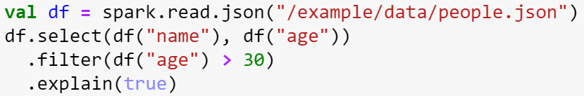
Logical query plan
== Optimized Logical Plan ==
Project [name#75,age#74L]
+- Filter (age#74L > 30)
+- Relation[age#74L,name#75] JSONRelation

Slide 46
Structured computation
 | Functions | Expressions
Scala code | (x: Int) => x > 30 | df(“x”) > 30
Compiles into | class $function1 { def apply(Int): Boolean } | GreaterThan(x,Literal(30))

Slide 47
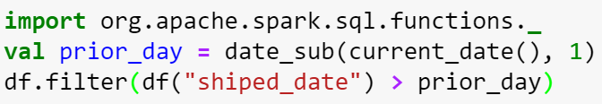
Catalyst Expressions
Support 100+ native functions
Optimized codegen implementation
Examples:
String manipulation – concat, format_string, lower
Data/time – current_timestamp, date_format, date_add
Math – sqrt, randn
Other – monotonicallyIncreasingId, sparkPartitionId

Slide 48
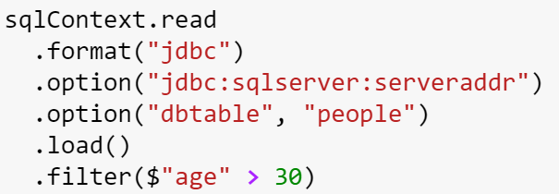
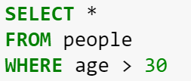
Predicate pushdown
Spark code
Query sent to SQL Server

Slide 49
Spark Structured Data Model
Primitives
Byte, Short, Integer, Long, Float, Double, Decimal, String, Binary, Boolean, Timestamp, Date
Array[Type]
Variable length collection
Struct
Fixed number of nested columns with fixed types
Map[Type, Type]
Variable length association

Slide 50
Tungsten’s compact row encoding
(123, “apache”, “spark”)
field length
field length
0x0
123
32
56
6
apache
5
spark
offset to data
null bitmask
offset to data

Slide 51
Tungsten’s compact encoding types
Row oriented
Column oriented (new in 2.0)
Used in vectorized processing of data (new Parquet reader)

Slide 52
Space efficiency
GBs
Databricks reported data

Slide 53
Serialization performance
million object / second
Databricks reported data

Slide 54
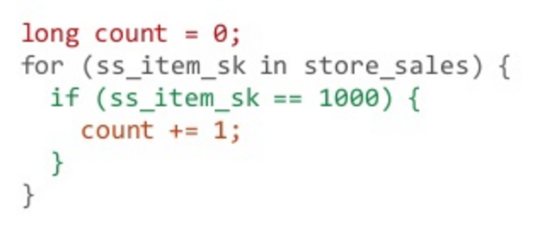
Whole-stage codegen: Spark as a Compiler
Aggregate
Project
Filter
Scan
Query plan

Slide 55
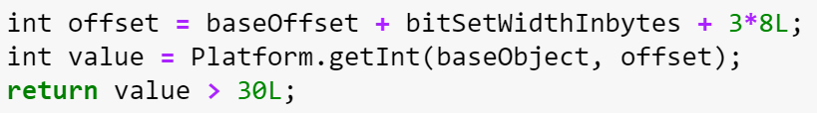
Generated code operates directly on compact encoding
DataFrame code | df(“age”) > 30
Catalyst expression | GreaterThan(age,Literal(30))
Generated code
JVM intrinsic operation,
will be JITed into pointer arithmetic

Slide 56
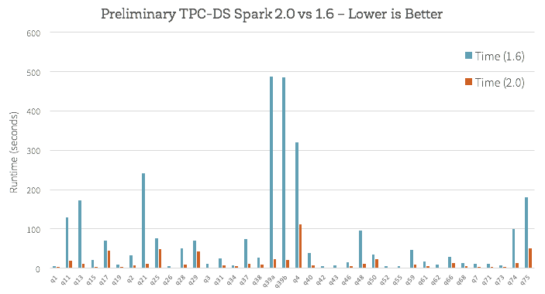
TPC-DS benchmark results
TPC-DS performance improvement is in the range of 3-10x
Databricks reported data

Slide 57
Demo
Hive tables
Notes:
Sources:
https://channel9.msdn.com/Series/Azure-Data-Lake/Whats-up-with-Spark25-SparkSQL
Microsoft Azure – BI Tools: Save raw data as a Hive table
https://azure.microsoft.com/en-us/documentation/articles/hdinsight-apache-spark-use-bi-tools/
Microsoft Azure – BI Tools: Use Power BI to analyze data in the Hive table
https://azure.microsoft.com/en-us/documentation/articles/hdinsight-apache-spark-use-bi-tools/
Microsoft Azure - Machine learning: Predictive analysis on food inspection data using MLlib with Spark on HDInsight: Construct an input dataframe
https://azure.microsoft.com/en-us/documentation/articles/hdinsight-apache-spark-machine-learning-mllib-ipython/

Slide 58
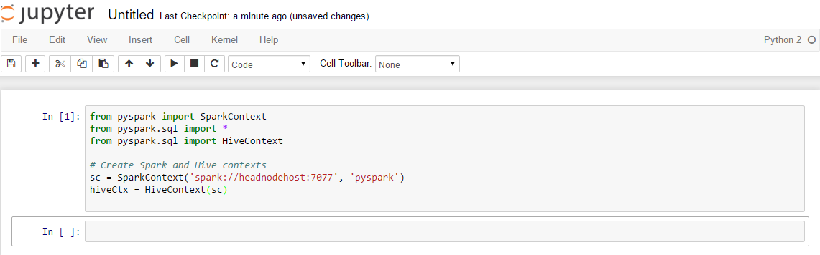
Notes:
Objective: This slide begins the Hive table demo.
Instructions:
In this section, we use the Jupyter notebook associated with an Apache Spark cluster in HDInsight to run jobs that process your raw sample data and save it as a Hive table. The sample data is a CSV file (hvac.csv) available on all clusters by default.
Once your data is saved as a Hive table, we will then connect to the Hive table using BI tools such as Microsoft Power BI and Tableau.
First, we need to import the required modules and create the SparkContext and HiveContext.
Every time you run a job in Jupyter, your web browser window title will show a (Busy) status along with the notebook title. You will also see a solid circle next to the Python 2 text in the top-right corner. After the job completes, this will change to a hollow circle.

Slide 59
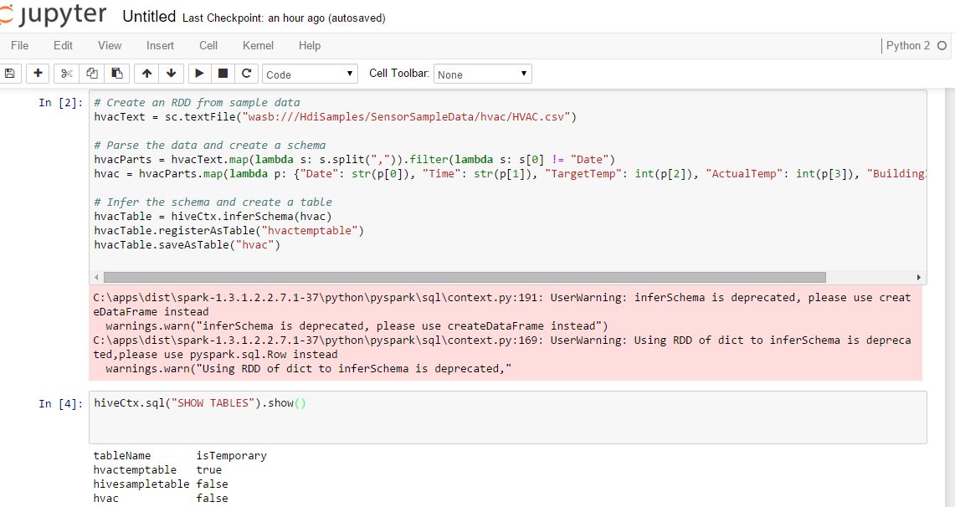
Notes:
Objective: This slide continues the Hive table demo.
Instructions:
Now we will load some sample data into a temporary table.
When you provision a Spark cluster in HDInsight, the sample data file, hvac.csv, is copied to the associated storage account under \HdiSamples\SensorSampleData\hvac. We will use this CSV and create a Hive Table.
If you look at the code, first we create an RDD from sample data. Then we create the required schema and parse the data.
Next, we register the data into a Hive table called HVAC. To verify that the table was successfully created, we provided the SQL command of Show table. Only the tables that have “false” under the isTemporary column are Hive tables that will be stored in the metastore and able to be accessed from the BI tools.

Slide 60
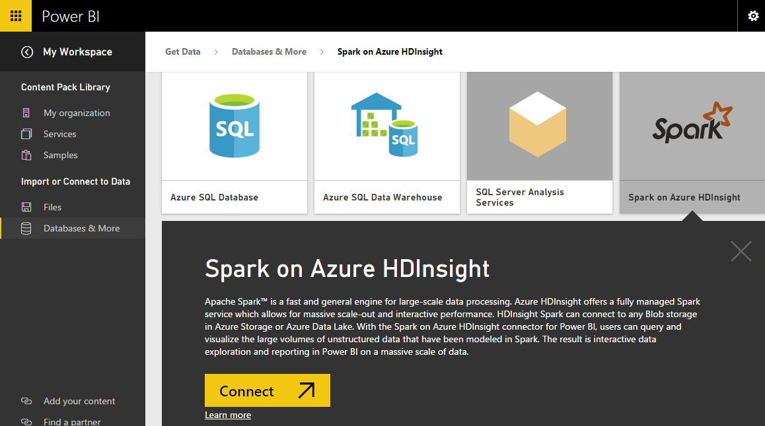
Notes:
Objective: This slide continues the Hive table demo.
Instructions:
Once you have saved the data as a Hive table, you can use Microsoft Power BI to connect to the data and visualize it to create reports, dashboards, and so on. Spark on Azure HDInsight with direct connect allows you to create dynamic reports based on data and metric you already have in your Spark cluster. With direct connect, queries are sent back to your Azure HDInsight Spark cluster as you explore the data in the report view. This experience is suggested for users who are familiar with the entities they connect to.

Slide 61
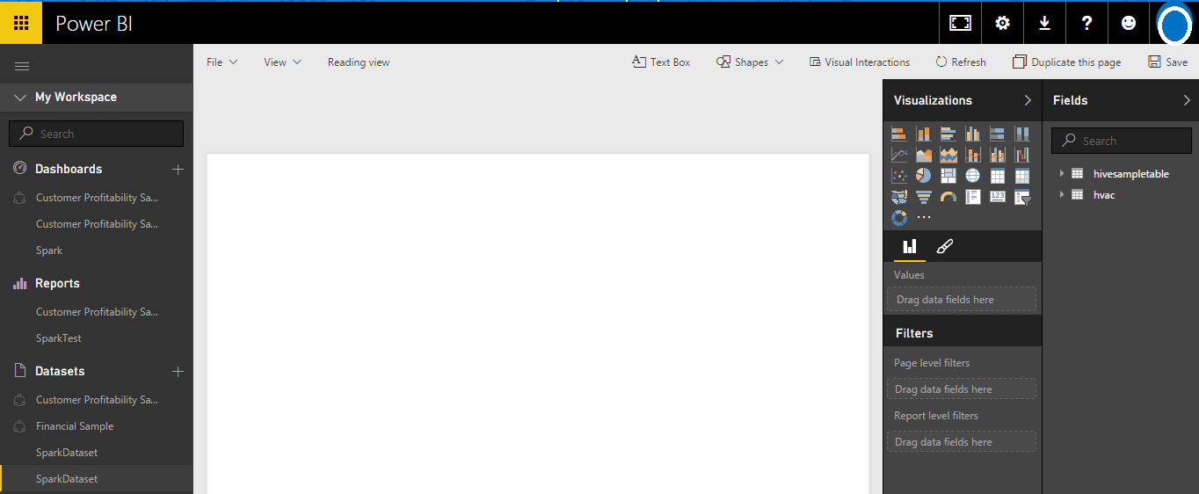
Notes:
Objective: This slide continues the Hive table demo.
Instructions:
After the connection is established, Microsoft Power BI starts importing data from the Spark cluster on HDInsight. Power BI imports the data and displays the new dashboard. A new data set is also added under the Datasets heading.

Slide 62
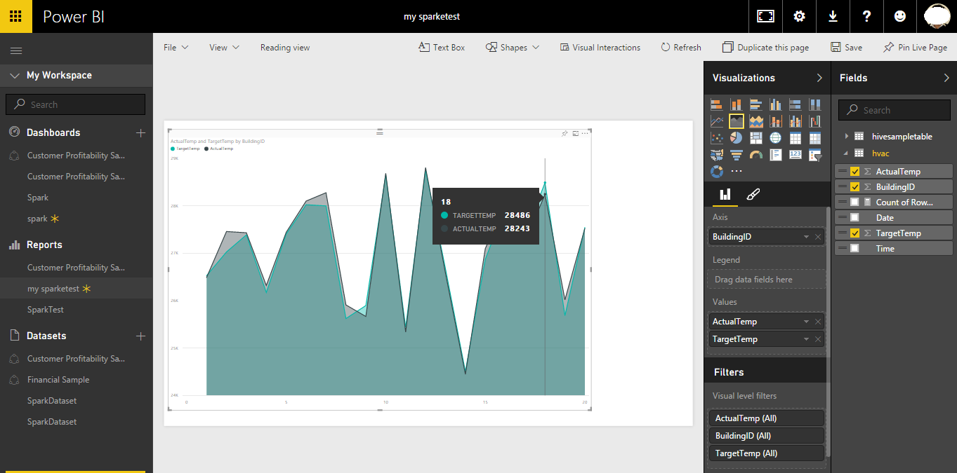
Notes:
Objective: This slide concludes the Hive table demo.
Instructions:
Build a visualization to show the variance between target temperature and actual temperature for each building. You just need to drag and drop the required fields into the respective axis and value. Move your cursor over the visualization to get tool tips with relevant data. You can also pin the visualization, storing it on your dashboard so you can track the latest value at a glance.
Also, Spark clusters on HDInsight are connected to Microsoft Power BI with direct connect. This means that Power BI always has the most up-to-date from your cluster so you do not need to schedule refreshes for the dataset.

Slide 63

© 2016 Microsoft Corporation. All rights reserved. Microsoft, Windows, Windows Vista and other product names are or may be registered trademarks and/or trademarks in the U.S. and/or other countries.
The information herein is for informational purposes only and represents the current view of Microsoft Corporation as of the date of this presentation. Because Microsoft must respond to changing market conditions, it should not be interpreted to be a commitment on the part of Microsoft, and Microsoft cannot guarantee the accuracy of any information provided after the date of this presentation. MICROSOFT MAKES NO WARRANTIES, EXPRESS, IMPLIED OR STATUTORY, AS TO THE INFORMATION IN THIS PRESENTATION.

Slide 64
Hands-on lab
Running interactive Spark SQL queries with Jupyter

Slide 65
© 2016 Microsoft Corporation. All rights reserved. Microsoft, Windows, Windows Vista and other product names are or may be registered trademarks and/or trademarks in the U.S. and/or other countries.
The information herein is for informational purposes only and represents the current view of Microsoft Corporation as of the date of this presentation. Because Microsoft must respond to changing market conditions, it should not be interpreted to be a commitment on the part of Microsoft, and Microsoft cannot guarantee the accuracy of any information provided after the date of this presentation. MICROSOFT MAKES NO WARRANTIES, EXPRESS, IMPLIED OR STATUTORY, AS TO THE INFORMATION IN THIS PRESENTATION.

Slide 66
Hands-on lab
Working with Hive and Power BI in Apache Spark

Slide 67
© 2016 Microsoft Corporation. All rights reserved. Microsoft, Windows, Windows Vista and other product names are or may be registered trademarks and/or trademarks in the U.S. and/or other countries.
The information herein is for informational purposes only and represents the current view of Microsoft Corporation as of the date of this presentation. Because Microsoft must respond to changing market conditions, it should not be interpreted to be a commitment on the part of Microsoft, and Microsoft cannot guarantee the accuracy of any information provided after the date of this presentation. MICROSOFT MAKES NO WARRANTIES, EXPRESS, IMPLIED OR STATUTORY, AS TO THE INFORMATION IN THIS PRESENTATION.

